Slide 1
Chapter 15 Event-Driven Programming and Animations

Slide 2
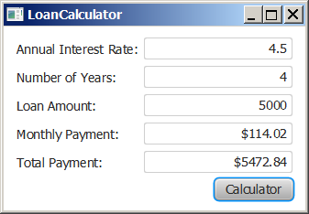
Motivations
Suppose you want to write a GUI program that lets the user enter a loan amount, annual interest rate, and number of years and click the Compute Payment button to obtain the monthly payment and total payment. How do you accomplish the task? You have to use event-driven programming to write the code to respond to the button-clicking event.
LoanCalculator

Slide 3
Procedural vs. Event-Driven Programming
Procedural programming is executed in procedural (sequential) order. Start with main and follow method calls.
In event-driven programming, code is executed upon activation of events. More difficult to follow sequence, but more efficient.

Slide 4
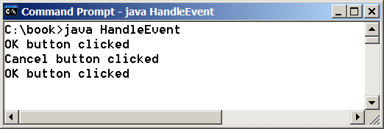
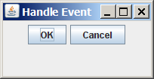
Taste of Event-Driven Programming
The example displays a button in the frame. A message is displayed on the console when a button is clicked.
HandleEvent

Slide 5
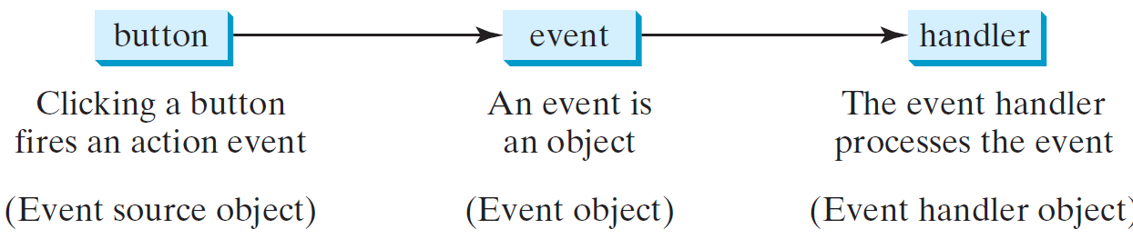
Handling GUI Events
Source object (e.g., button)
Listener object contains a method for processing the event.
Programmer adds source to GUI and writes handler method/class.
5

Slide 6
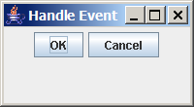
Trace Execution
animation
public class HandleEvent extends Application {
public void start(Stage primaryStage) {
…
OKHandlerClass handler1 = new OKHandlerClass();
btOK.setOnAction(handler1);
CancelHandlerClass handler2 = new CancelHandlerClass();
btCancel.setOnAction(handler2);
…
primaryStage.show(); // Display the stage
}
}
class OKHandlerClass implements EventHandler<ActionEvent> {
@Override
public void handle(ActionEvent e) {
System.out.println("OK button clicked");
}
}
1. Start from the main method to create a window and display it
6

Slide 7
Trace Execution
animation
public class HandleEvent extends Application {
public void start(Stage primaryStage) {
…
OKHandlerClass handler1 = new OKHandlerClass();
btOK.setOnAction(handler1);
CancelHandlerClass handler2 = new CancelHandlerClass();
btCancel.setOnAction(handler2);
…
primaryStage.show(); // Display the stage
}
}
class OKHandlerClass implements EventHandler<ActionEvent> {
@Override
public void handle(ActionEvent e) {
System.out.println("OK button clicked");
}
}
2. Click OK
7

Slide 8
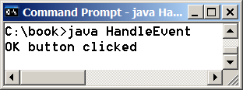
Trace Execution
animation
public class HandleEvent extends Application {
public void start(Stage primaryStage) {
…
OKHandlerClass handler1 = new OKHandlerClass();
btOK.setOnAction(handler1);
CancelHandlerClass handler2 = new CancelHandlerClass();
btCancel.setOnAction(handler2);
…
primaryStage.show(); // Display the stage
}
}
class OKHandlerClass implements EventHandler<ActionEvent> {
@Override
public void handle(ActionEvent e) {
System.out.println("OK button clicked");
}
}
3. Click OK. The JVM invokes the listener’s handle method
8

Slide 9
Events
An event can be defined as a type of signal to the program that something has happened.
The event is generated by external user actions such as mouse movements, mouse clicks, or keystrokes.

Slide 10
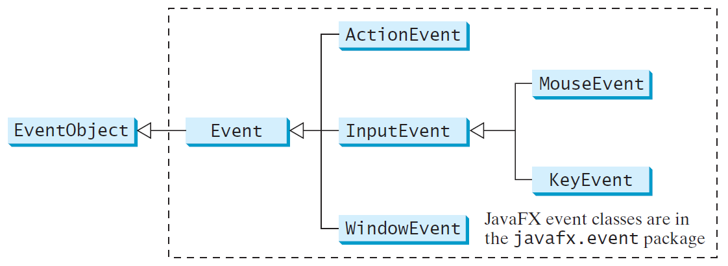
Event Classes

Slide 11
Event Information
An event object contains whatever properties are pertinent to the event.
You can identify the source object of the event using the getSource() instance method in the EventObject class.
The subclasses of EventObject deal with special types of events, such as button actions, window events, component events, mouse movements, and keystrokes.
Table 15.1 lists external user actions, source objects, and event types generated.

Slide 12
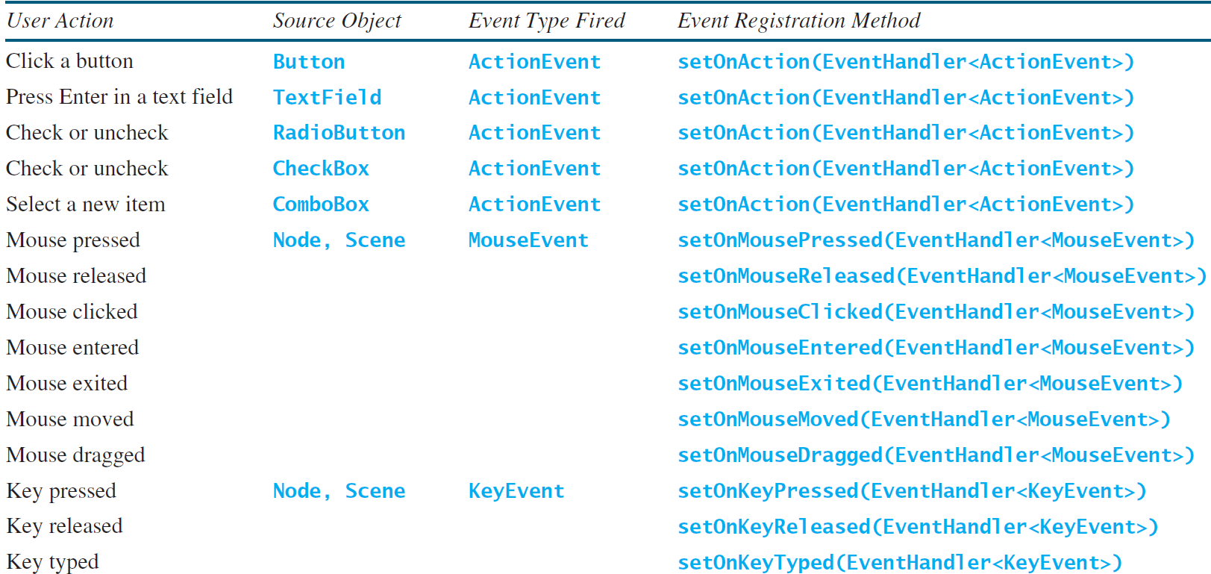
Selected User Actions and Handlers

Slide 13
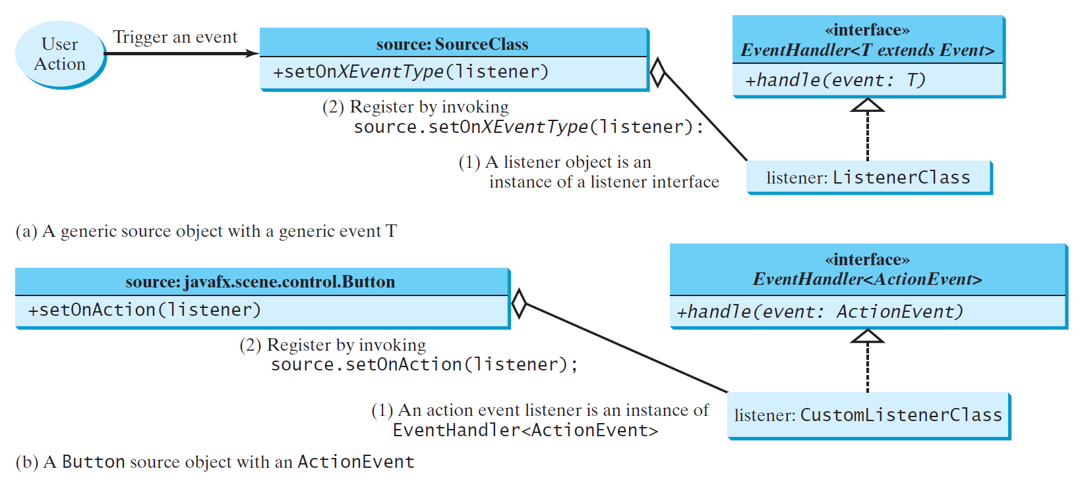
The Delegation Model

Slide 14
The Delegation Model: Example
Button btOK = new Button("OK");
OKHandlerClass handler = new OKHandlerClass();
btOK.setOnAction(handler);

Slide 15
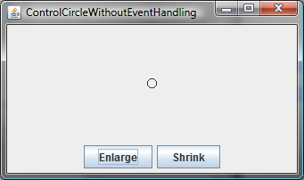
Example: First Version for ControlCircle (no listeners)
Now let us consider to write a program that uses two buttons to control the size of a circle.
ControlCircleWithoutEventHandling

Slide 16
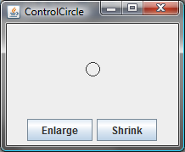
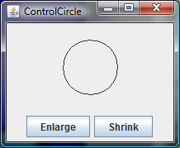
Example: Second Version for ControlCircle (with listener for Enlarge)
Now let us consider to write a program that uses two buttons to control the size of a circle.
ControlCircle

Slide 17
Inner Class Listeners
A listener class is designed specifically to create a listener object for a GUI component (e.g., a button). It will not be shared by other applications. So, it is appropriate to define the listener class inside the frame class as an inner class.

Slide 18
Inner Classes
Inner class: A class is a member of another class.
Advantages: In some applications, you can use an inner class to make programs simple.
An inner class can reference the data and methods defined in the outer class in which it nests, so you do not need to pass the reference of the outer class to the constructor of the inner class. It can not typically be seen by any other classes.

Slide 19
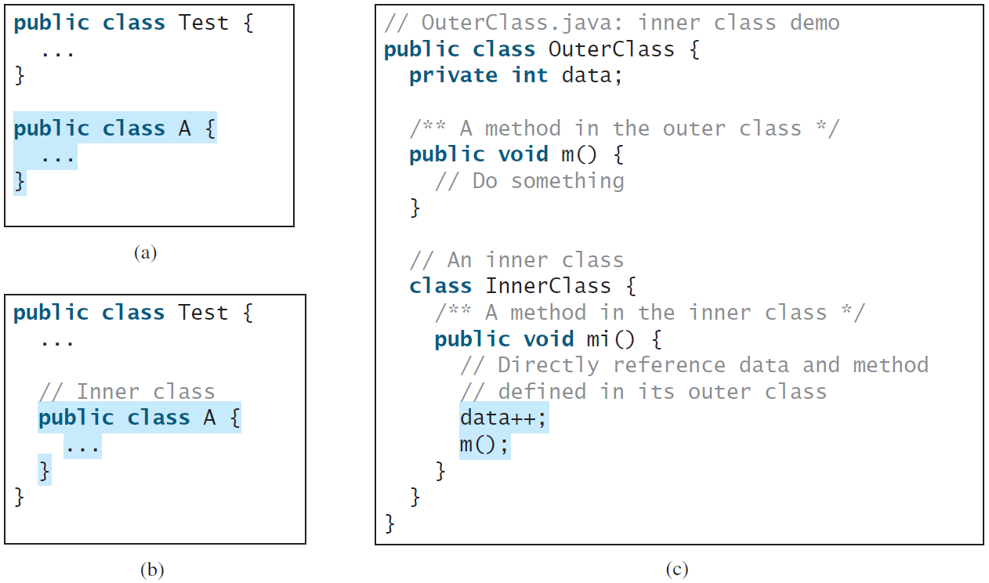
Inner Classes, cont.

Slide 20
Inner Classes (cont.)
Inner classes can make programs simple and concise.
An inner class supports the work of its containing outer class and is compiled into a class named OuterClassName$InnerClassName.class. For example, the inner class InnerClass in OuterClass is compiled into OuterClass$InnerClass.class.

Slide 21
Inner Classes (cont.)
An inner class can be declared public, protected, or private subject to the same visibility rules applied to a member of the class.
An inner class can be declared static. A static inner class can be accessed using the outer class name. A static inner class cannot access nonstatic members of the outer class

Slide 22
Anonymous Inner Classes
An anonymous inner class must always extend a superclass or implement an interface, but it cannot have an explicit extends or implements clause.
An anonymous inner class must implement all the abstract methods in the superclass or in the interface.
An anonymous inner class always uses the no-arg constructor from its superclass to create an instance. If an anonymous inner class implements an interface, the constructor is Object().
An anonymous inner class is compiled into a class named OuterClassName$n.class. For example, if the outer class Test has two anonymous inner classes, these two classes are compiled into Test$1.class and Test$2.class.

Slide 23
Anonymous Inner Classes (cont.)
Inner class listeners can be shortened using anonymous inner classes. An anonymous inner class is an inner class without a name. It combines declaring an inner class and creating an instance of the class in one step. An anonymous inner class is declared as follows:
new SuperClassName/InterfaceName() {
// Implement or override methods in superclass or interface
// Other methods if necessary
}

Slide 24
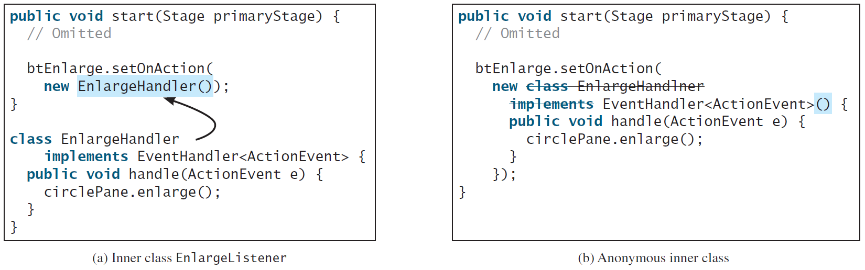
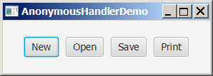
Anonymous Inner Classes (cont.)
AnonymousHandlerDemo

Slide 25
Simplifying Event Handing Using Lambda Expressions
Lambda expression is a new feature in Java 8. Lambda expressions can be viewed as an anonymous method with a concise syntax. For example, the following code in (a) can be greatly simplified using a lambda expression in (b) in three lines.

Slide 26
Basic Syntax for a Lambda Expression
The basic syntax for a lambda expression is either
(type1 param1, type2 param2, ...) -> expression
or
(type1 param1, type2 param2, ...) -> { statements; }
The data type for a parameter may be explicitly declared or implicitly inferred by the compiler. The parentheses can be omitted if there is only one parameter without an explicit data type.

Slide 27
Single Abstract Method Interface (SAM)
The statements in the lambda expression is all for that method. If it contains multiple methods, the compiler will not be able to compile the lambda expression. So, for the compiler to understand lambda expressions, the interface must contain exactly one abstract method. Such an interface is known as a functional interface, or a Single Abstract Method (SAM) interface.
AnonymousHandlerDemo

Slide 28
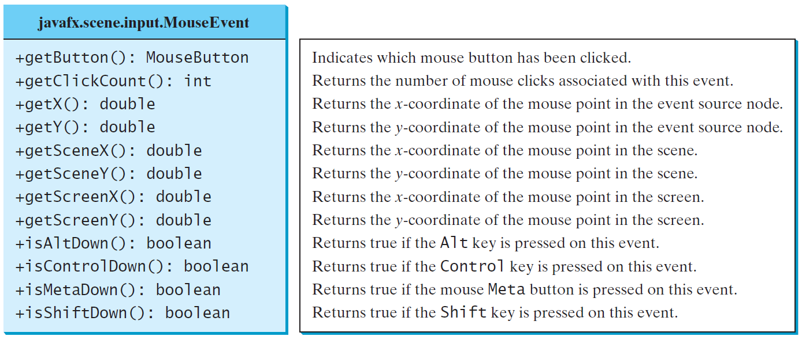
MouseEvent
MouseEventDemo

Slide 29
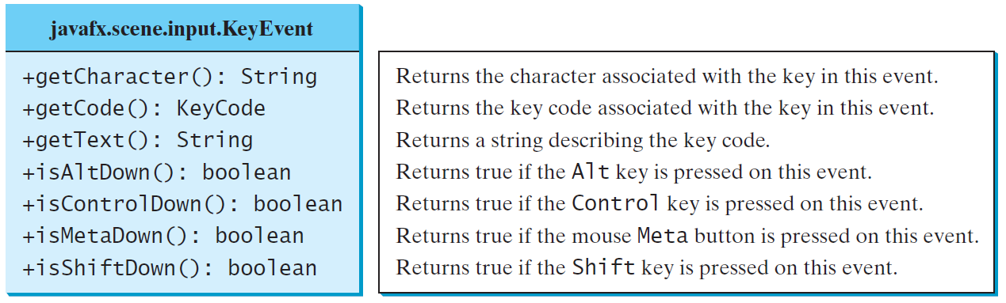
The KeyEvent Class
MouseEventDemo

Slide 30
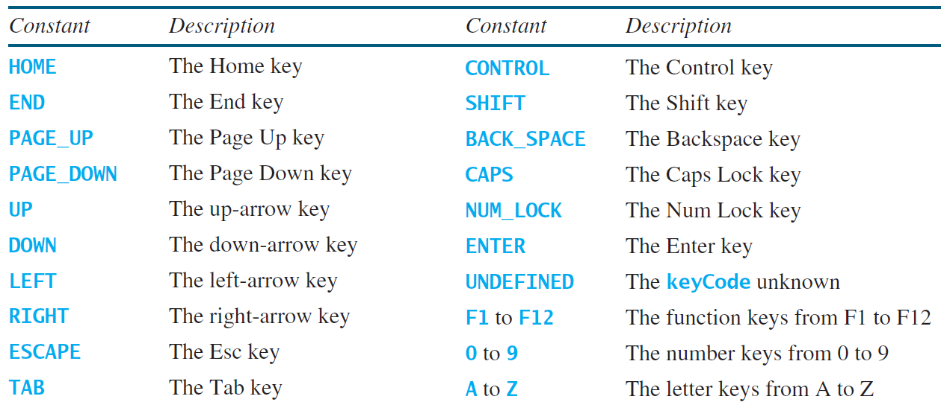
The KeyCode Constants

Slide 31
Example: Control Circle with Mouse and Key
ControlCircleWithMouseAndKey

Slide 32
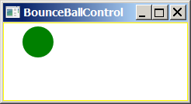
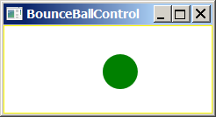
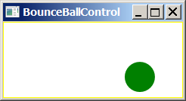
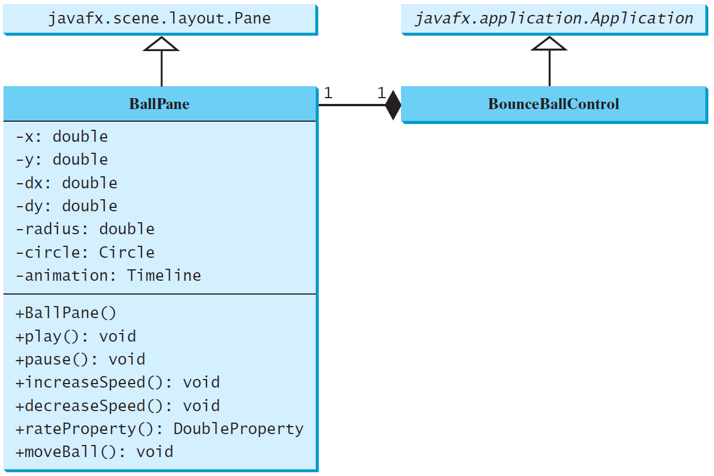
Case Study: Bouncing Ball
BallPane
BounceBallControl

